Slide 1



Climate Finance RAG System Using LLMs
An AI-powered system for retrieving and analyzing climate finance documents
by Hager Ashour
Notes:
1

Slide 2
Introduction: Addressing the Challenge
Time-consuming document analysis
AI-powered system for efficient information retrieval
Notes:
2

Slide 3

System Overview: Technology Stack
LLM: Mistral-7B
Vector Database: ChromaDB
Embeddings: MiniLM
Frameworks: LangChain, Hugging Face, FastAPI, Gradio
Notes:
3

Slide 4
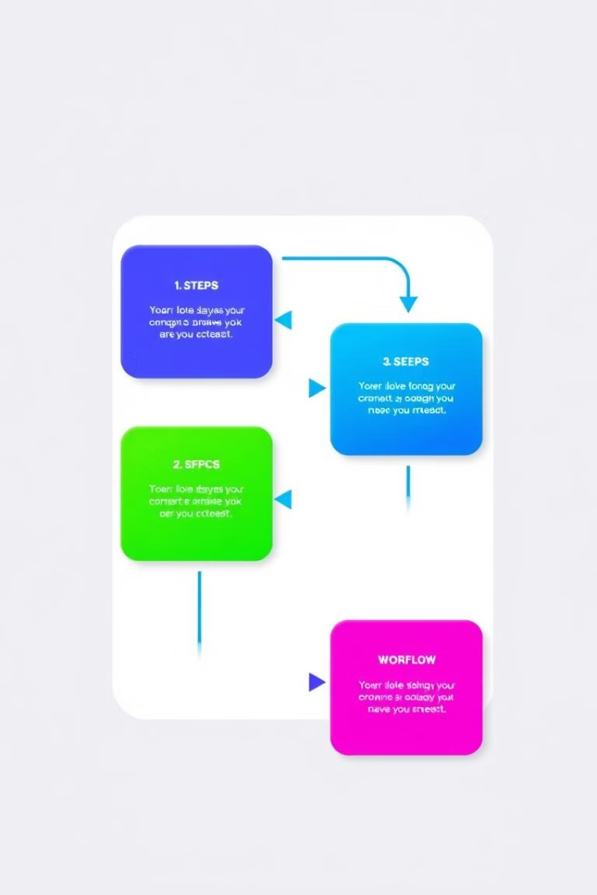
Methodology: Step-by-Step Approach
Data collection and preprocessing
1
Indexing and vector storage
2
LLM querying (RAG System)
3
Evaluation and refinement
4
Notes:
4

Slide 5
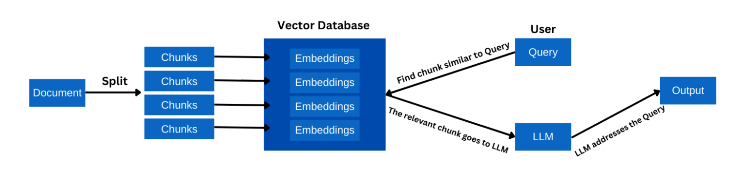




System Architecture: Visualizing the Pipeline
User input
Retrieve relevant documents
LLM generates response
Evaluation metrics
Notes:
5

Slide 6
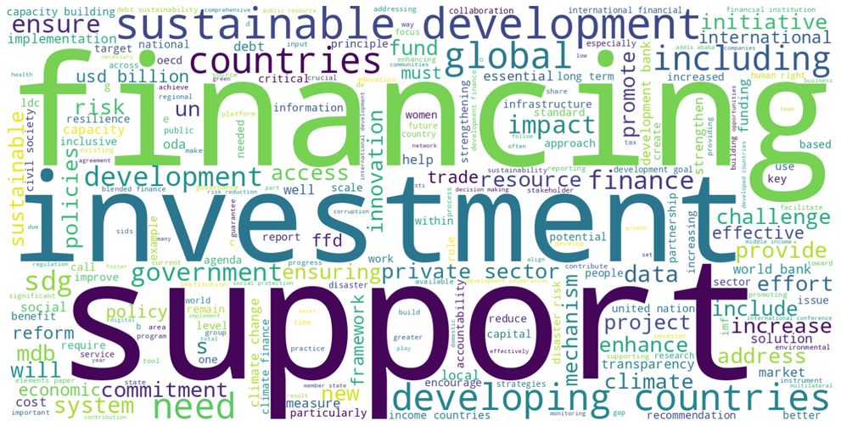
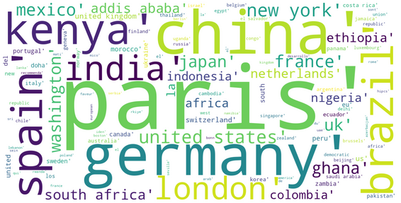
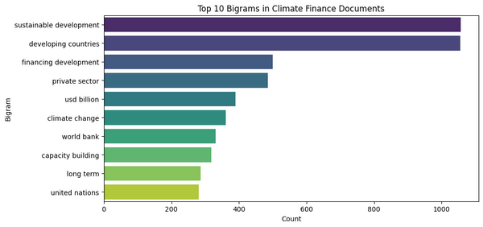
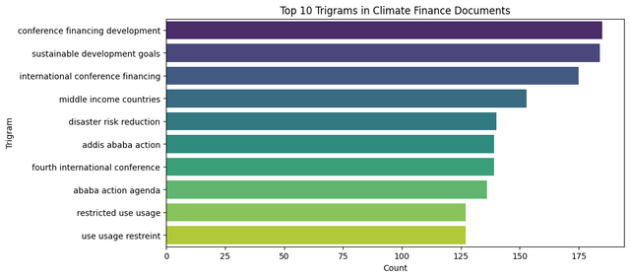
Key Insights from Data Analysis
Most common topics
Country mentions
Sentiment analysis
Notes:
7

Slide 7
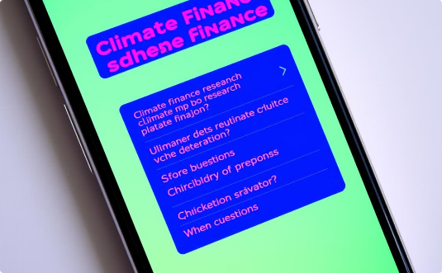
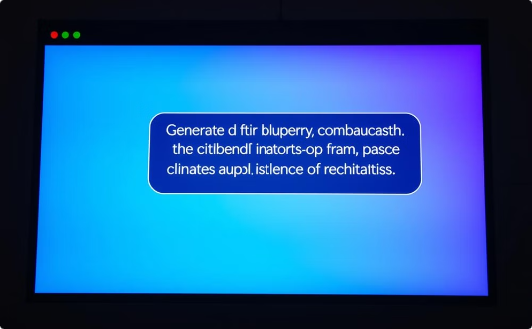
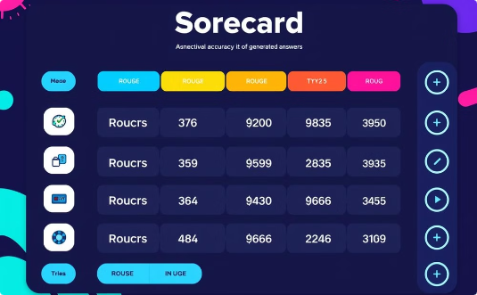
Demonstration: Gradio User Interface
Question dropdown
Generated answers
ROUGE scores
Notes:
6

Slide 8
Challenges & Limitations: Addressing the Gaps
File validation
Performance bottlenecks
Evaluation limitations
Notes:
8

Slide 9




Future Improvements: Next Steps in Development
Deployment: FastAPI
Code management: VS Code & GitHub
Model inference speed: GPU-based inference
Notes:
9

Slide 10

Conclusion
RAG system for climate finance research
Accurate and efficient answers
Focus on scalability, evaluation, and deployment
Notes:
10

